Slide 1

A Machine Learning Approach for Predicting Quality of Life among Asian Americans
ST 4035 - GROUP B
Notes:
Good morning everyone, Today, we'll be exploring a project titled 'A Machine Learning Approach for Predicting Quality of Life among Asian Americans in City of Austin. we aim to highlight the methods, findings, and potential implications of applying machine learning to assess quality of life (or QOL) in this community

Slide 2


Objective
The objective of this project is to identify the main factors that affect the Quality of Life (QoL) of Asian Americans and to evaluate them using appropriate machine learning techniques.
Notes:
The objective of this project is to identify the main factors that affect the Quality of Life (QoL) of Asian Americans and to evaluate them using appropriate machine learning techniques.

Slide 3
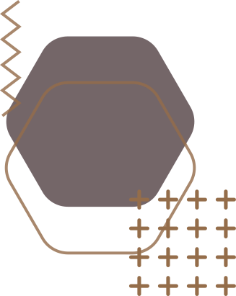



INTRODUCTION TO DATASET
DESCRIPTION :
The data set used for this project was obtained from DATA.GOV which was based on a survey done by the government of Austin, Texas. It consists of 2609 rows and 231 columns which includes both numerical and categorical variables.
Observations: 2609
Variables: 231
Categorical :190
Numerical:41
Notes:
Our dataset for this project was sourced from DATA.GOV, based on a survey conducted by the government of Austin, Texas. It includes 2,609 observations and 231 variables, covering both numerical and categorical data types.

Slide 4


231 Variables
We overcame this problem of messy, tangled dataset by splitting it into 7 sections as given in the Description file
Benifits :
Enabled us to give individual attention to each variable.
Efficient extraction of insights without data loss.
Were able to study deep about variables and merge/ remove/ tranform
Notes:
To manage the dataset’s complexity, we split the 231 variables into 7 sections. This helped us focus on each variable individually, extract insights efficiently, and make necessary adjustments—such as merging, removing, or transforming—without losing information.

Slide 5
Preprocessing
Checking Abnormilities /Outliers
STEP 1
Thoroughly digging deeper into variaables
STEP 2
Removing Features
STEP 3
Data Imputation
Dropping Irrelevant Features
STEP 4
Variables that did not have significant relationships with the response were removed
STEP 5
Encoding
STEP 6
Recategorizing the Response
Notes:
Prior to analyzing the data, preprocessing steps were necessary to ensure data quality and derive meaningful interpretations. These steps included checking outliers/ abnormalities, handling missing values, encoding variables, and reducing unnecessary features in each section.

Slide 6

Preprocessing
Row Deletion: Rows entirely filled with missing values
Missing values of the response variable ‘Quality of Life’
Column Deletion: Columns with more than 20% missing values were identified and removed from the dataset.
Checking Abnomalities in levels
category levels named ‘0’, ‘2’, ‘3’, ‘4’, and ‘11’ instead of ‘Yes’, and ‘No’ for some columns.
nominal categorical levels also had level names like ‘5’, '6', '10', '11', and '33' that didn’t give any meaning.
These columns were considered as missing values.
NAN
Some columns levels had abnormal level names which had high value counts.
Status of Ownership [3] - 78
Housing [5] - 53
We figured out that these were not missing values but belong to the ‘Other’ category which had a text description in the dataset. “Other”
Notes:
The dataset underwent a cleaning process where rows entirely filled with missing values were removed and the rows where the response variable ‘Quality of Life’ were missing were deleted from the dataset
The proportion of missing values was calculated for each column and Columns which had more than 20% missing values were identified and removed from the dataset.
Then we ,Carefully observed the value counts of the categorical variable whether there are any abnormalities in the levels.

Slide 7
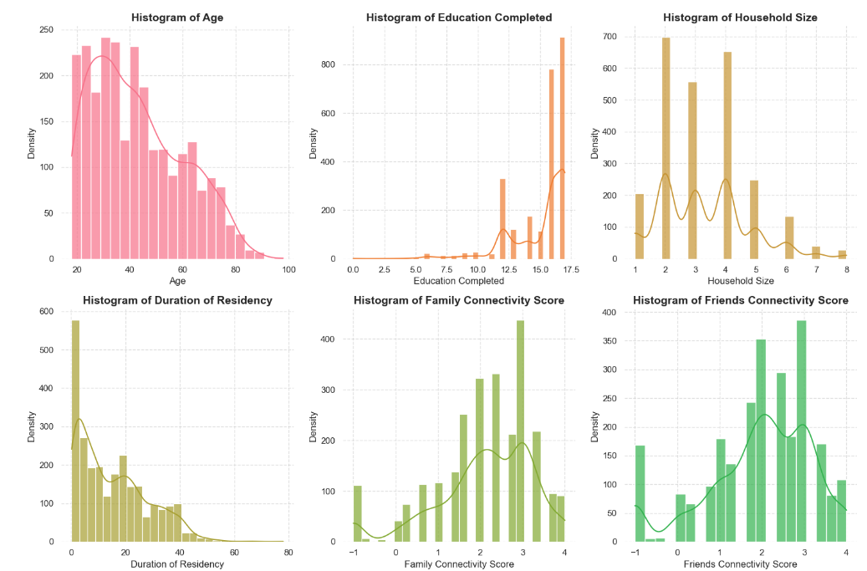
Preprocessing
Outliers
Graphically visualized the numerical data using histograms
No abnormal data found
The columns that had levels were converted to categorical data type
Missing Value Imputation
Categorical features
Mode imputation
Numerical variables
Based on the data distribution
mean imputation was applied for symmetric distributions
median imputation for skewed distributions.
Notes:
Graphically visualized the numerical variables and identified that there were few variables that we could convert into object data type as it contained level data. Also we didn’t observe any outliers from the graphical analysis.
Missing values in categorical features were imputed using the mode, as it best represents the most common category in each variable.
For numerical variables, missing values were imputed based on the data distribution—mean imputation was applied for symmetric distributions, and median imputation for skewed distributions. This approach preserved the central tendency of the data without introducing significant bias.

Slide 8
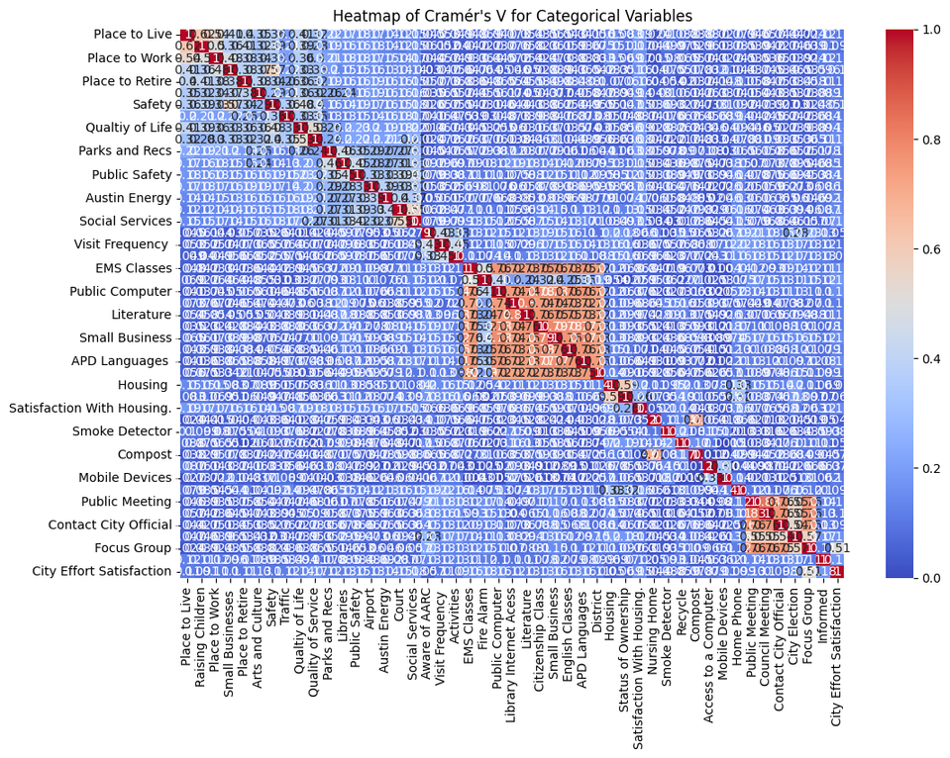
Merging Columns
Cramer’s V heatmap for the categorical variables.
Observed a high correlation between variables that were placed consecutively.
Columns were aggregated based on themes to create new composite variables to remove multicollinearity. For example,
Awareness of Services: Marks respondents as "Aware" if they used any listed services, such as EMS Classes or Library Internet Access.
Civic Engagement: Labels respondents as "Engaged" if they participated in activities like Public Meetings or City Elections.
Communication Methods: Categorized into City-based, Non-City-based Ethnic, and Non-City-based General Sources.
Mode of Transport: Combined transportation types into a single categorical variable.
Combined the 3-1-1 columns and the 9-1-1 columns into a single column ‘3-1-1_9_1_1’.
Notes:
After Applying Cramer’s V heatmap for the categorical variables we observed a high correlation between variables that were placed consecutively. Specific columns were aggregated based on themes to create new composite variables to remove multicollinearity.
Awareness of Services, Civic Engagement, Mode of Transport are some examples.
The newly created variables were kept, and the variables used to merge were then deleted from the dataset.
All the separately preprocessed sections were then merged together by using the index as the ‘Survey ID’. The resulting dataset altogether contained 148 variables.

Slide 9
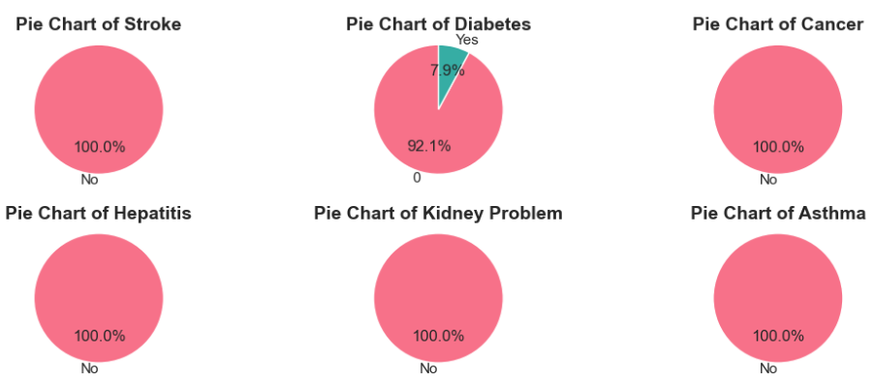
Dropping Irrelevant Features
Columns where all values were unique were dropped, as they did not contribute meaningful patterns or variability to the analysis.
Variables that like ‘Satisfied with Life 1’, ‘Satisfied with Life 1’ were also dropped.
Duplicate Handling
No duplicate entries were found during inspection.
Notes:
Columns where all values were unique were dropped, as they did not contribute meaningful patterns or variability to the analysis.
No duplicate entries were found during inspection.

Slide 10


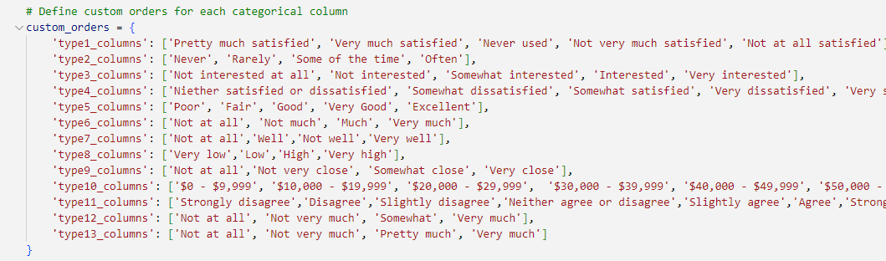
Encoding and Scaling
Standard Scaler
Numerical Variables
OneHot Encoder
Nominal Variables
Ordinal Encoder
Ordinal Variables
Custom Ordinal Encoding
Notes:
Next the data set was encoded and scaled using the below scalers to ensure that the models can be fitted easily.
Numerical values were scaled using Standard Scaler.
And for encoding
Nominal variables were encoded using OneHotEncoder while the ordinal variables which had orders were encoded using OrdinalEncoder.
We incorporated a custom order to encode the ordinal variables. You can see how we ordered them in the slide by catergorising them.

Slide 11
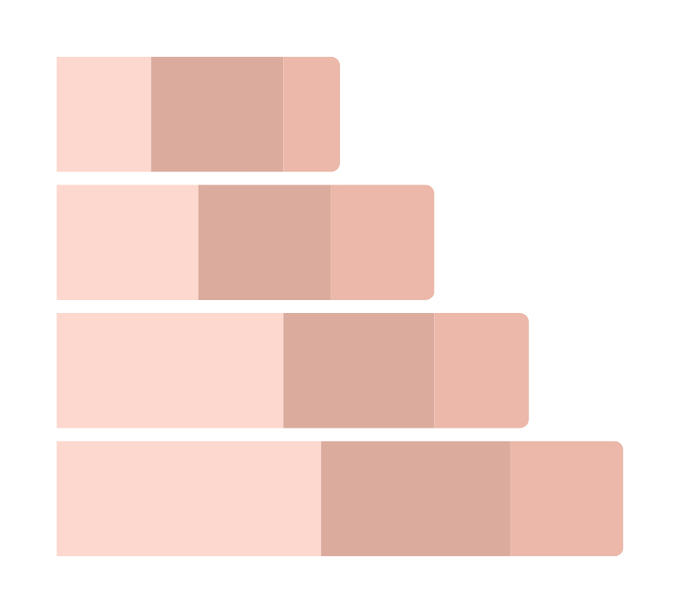
DESCRIPTIVE ANALYSIS
Notes:
Under the descriptive analysis first we did univariate analysis for our variables.

Slide 12
UNIVARIATE ANALYSIS

Slide 13
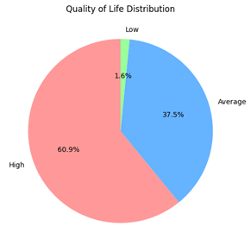
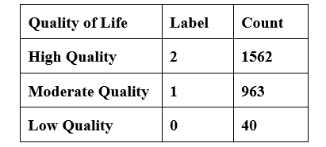

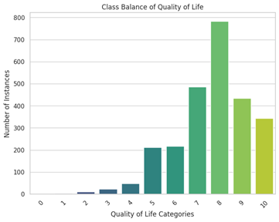
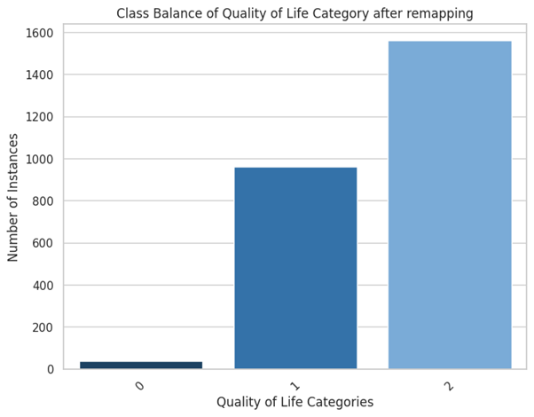

Response : Quality of Life
Notes:
The response quality of life had 11 distinct categories. These were recategorized into 3 categories. After categorizing still, the low quality category had the lowest number of counts.

Slide 14
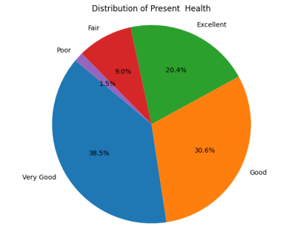
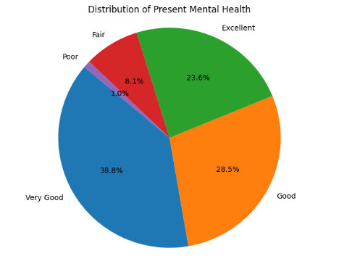
Mental and Overall Health Conditions
Notes:
When considering the health status of the individuals in Austin, a majority of them have voted that they have very good or good overall health. Only a few have voted as poor.
In mental health graph also this is the same as overall health. Here the percentage of poor is even lower.

Slide 15
BIVARIATE ANALYSIS
Notes:
Now let’s move on to the bivariate analysis.

Slide 16
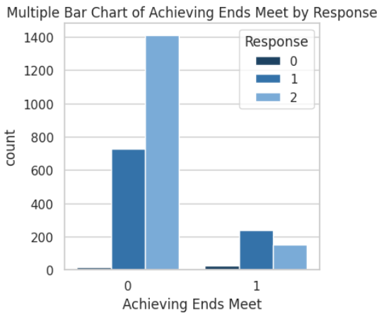
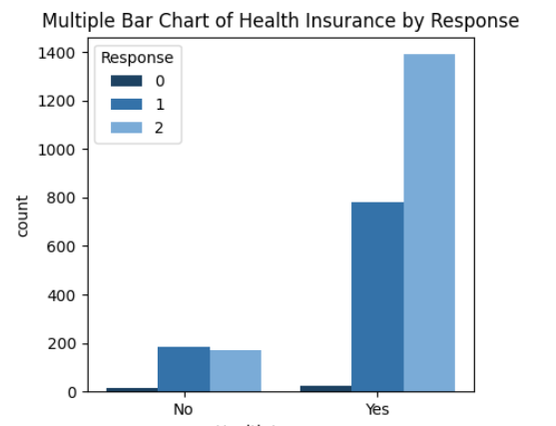
Financial Status
Notes:
The clustered bar chart of financial status shows that when people have just enough money to live, they have a average quality life. If they are above this, then most of the people are having high quality lives.
When checking whether the people have health insurance, most people who have high quality lives have an insurance, From the ones who do not have insurance many of them have average quality lives. This means ones with low quality lives are not able to afford an insurance.

Slide 17
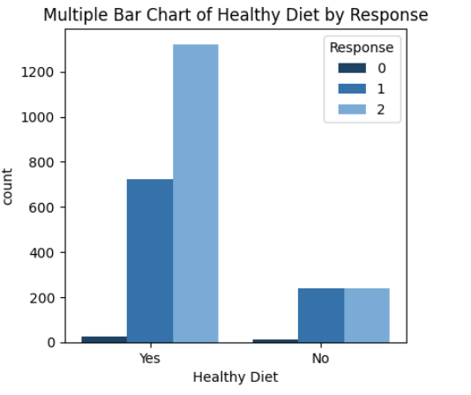
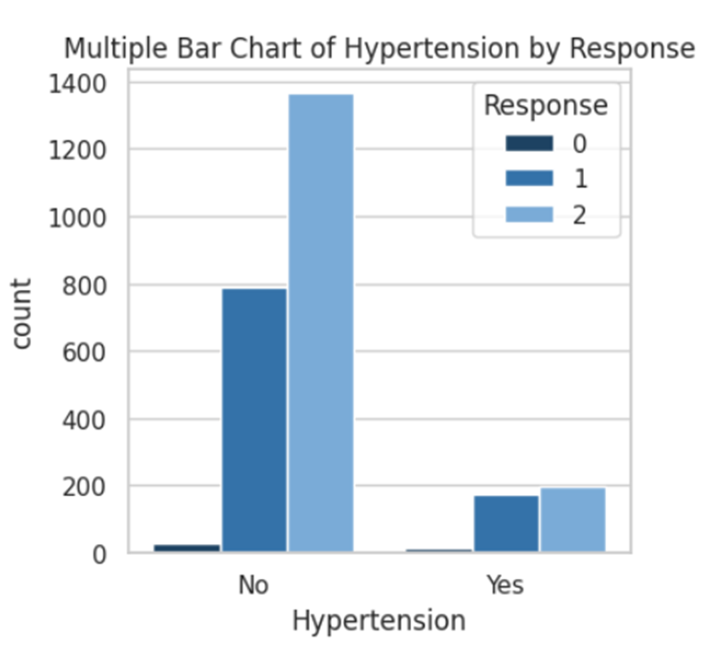
Health Status
Notes:
In health status, if people have a healthy diet, most of them have high quality lives where only a few have low quality. When asked whether they have hypertension, if they do not have hypertension the quality of life is high or average. Even from the ones having hypertension majority have high quality.

Slide 18
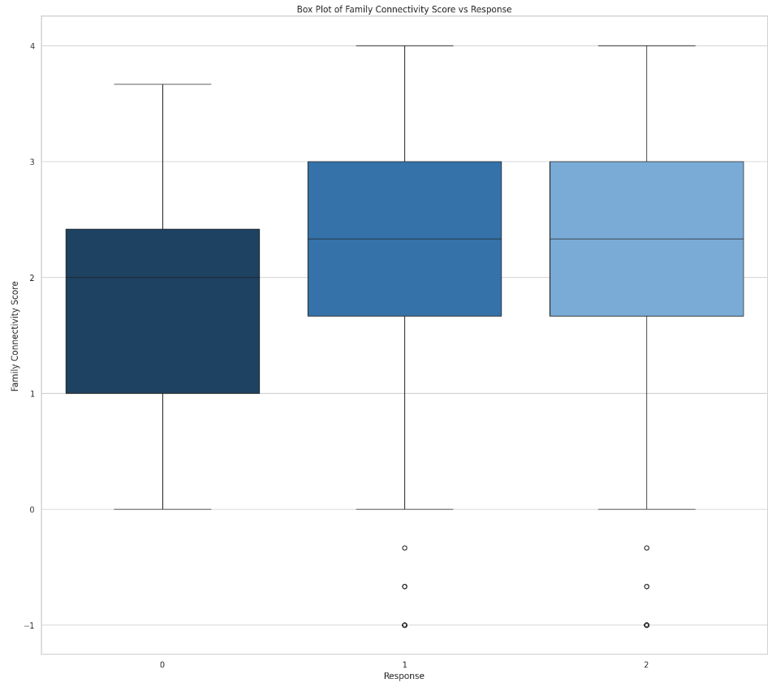
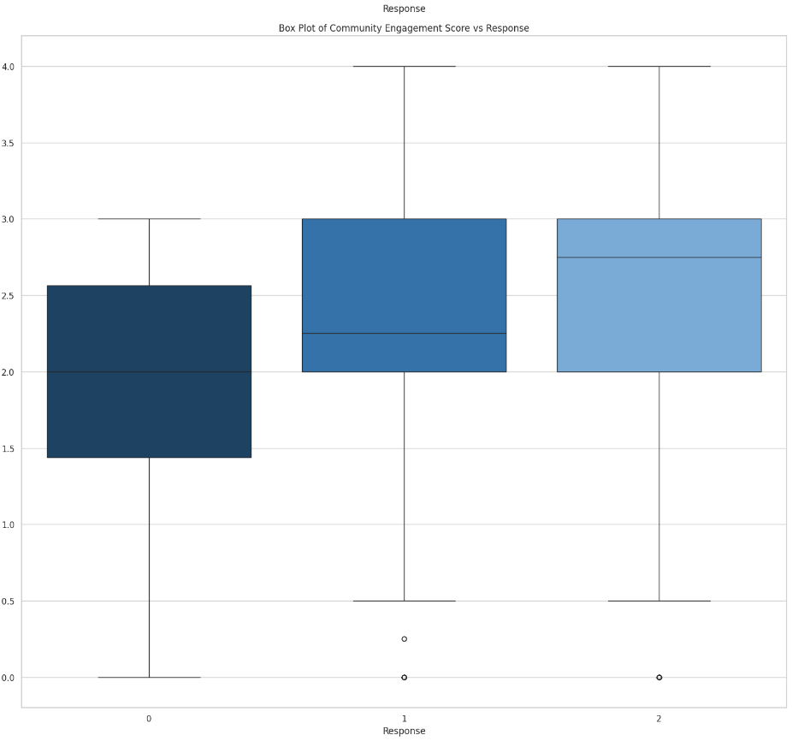
Connections with Family and Community
Notes:
When considering the engagement with family and community, we can see that people who have high and average quality lives both have approximately the same median family connectivity score. The low quality lives have a lower score. This means as the connectivity with the family increases the quality of life also increases.
This is similar to community engagement as well. It has highest score when high quality, then next average quality and lowest ones for low quality. There are few outliers in both graphs.

Slide 19


MULTICOLLINEARITY
Two or more predictor variables are highly correlated.
One or more predictors can be linearly predicted from the others
with a significant degree of accuracy.
The dataset comprises both categorical and numerical variables.
To assess multicollinearity:
The variables were separated into two groups: categorical and numerical.
For categorical variables:
A heatmap was plotted using Cramér's V to visualize the strength of associations.
For numerical variables:
A heatmap was created using Pearson's correlation coefficient to evaluate the correlations between predictors.
Notes:
The dataset includes both categorical and numerical variables, Therefore they were separated to assess multicollinearity. A Cramér's V heatmap visualized associations among categorical variables, while a Pearson correlation heatmap examined correlations among numerical predictors.

Slide 20
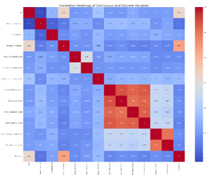
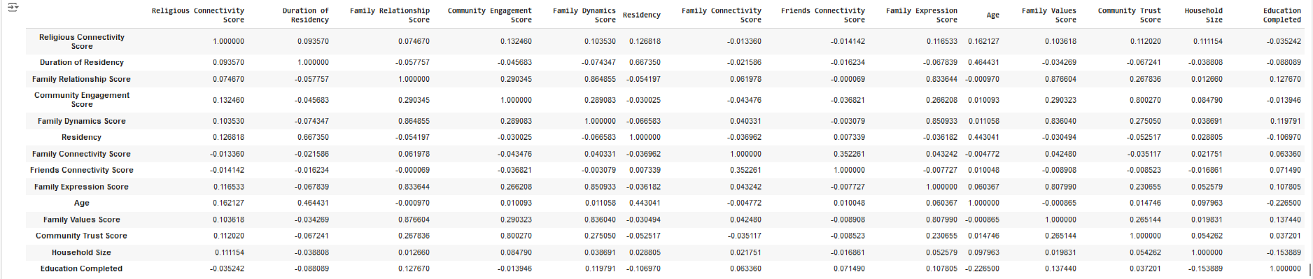
CORRELATION
We observed that several variables exhibited significant relationships with one another:
Family-Related Scores:
The Family Relation Score, Family Value Score, Family Expression Score, and Family Dynamic Score showed notably high multicollinearity
Community-Related Scores:
Similarly, the Community Engagement Score and Community Trust Score also exhibited significantly high multicollinearity.
Notes:
Multicollinearity among numerical variables was assessed using the Pearson correlation coefficient, visualized through a heatmap. High correlations were observed within (Family Value Score, Family Expression Score, and Family Dynamic Score ) which were then combined to one variable as family-related scores and (Community Engagement and Trust Scores).which were then combined to one variable as community-related scores

Slide 21
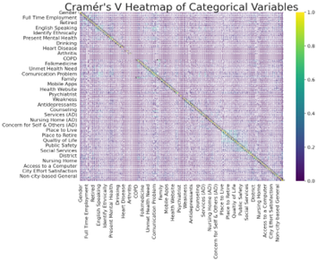
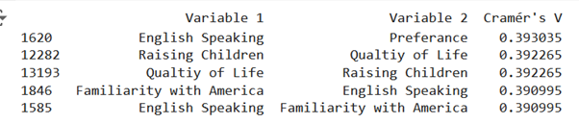
MULTICOLLINEARITY
AMONG CATEGORICAL
VARIABLES
Cramér's V to measure the correlation between categorical variables.
This measure, ranging from 0 to 1, is calculated from the Chi-square statistic and adjusts for contingency table size.
A heatmap was created created using the calculated Cramér's V values to visualize the strength of these relationships, identifying strong and weak associations.The heat-map indicates that none of the categorical variables have multicollinearity.
Notes:
Categorical variables were analyzed using Cramér's V to assess association strength, with values ranging from 0 to 1. A heatmap showed generally weak associations, with top values around 0.3, indicating low relationships among variables. Due to this, further in-depth analysis was deemed unnecessary.

Slide 22
CLUSTER ANALYSIS
Identifying Homogeneous Groups
Clustering segments individuals with similar needs, preferences, and behaviors, enabling more tailored interventions.
Targeted Interventions
Allows policymakers and health professionals to design specific programs addressing unique challenges of each group, such as specialized health services or community support.
Understanding Patterns
Reveals underlying trends in QoL data, helping identify demographic groups affected by social or economic factors.
Resource Allocation
Informs efficient distribution of resources; for example, clusters with a high need for mental health support can receive prioritized resources.
Monitoring Changes Over Time
Tracks shifts in QoL within groups, aiding in evaluating intervention effectiveness and adapting policies as needed.
Notes:
Now lets look at why checking the presence of clustering is important?
Clustering identifies groups with similar needs and behaviors, enabling targeted interventions and tailored programs. It reveals patterns in quality of life data, highlighting demographics affected by social or economic factors. This approach also aids efficient resource allocation, prioritizing high-need groups for support.

Slide 23







CLUSTERING
APPROACHES
KMeans
We can use KMeans for mix type data as well by changing the distance mesures.We have used Hamming distance for catergorical variables and Euclidian distance for the numerical variables
KPrototype
Kmedoids
Since our data consist of both categorical and quantitative (mixed type ) data
We can use kmedoids for mix type data as well by changing the distance mesures.We have used Hamming distance for catergorical variables and Euclidian distance for the numerical variables
Notes:
We applied three clustering algorithms—K-Prototypes, K-Medoids, and K-Means—suitable for our dataset's mixed categorical and numerical variables. Each algorithm required a distinct approach for effective data handling. Now ; We will outline the configurations used and the evaluation metrics employed to determine the optimal number of clusters for each method.

Slide 24

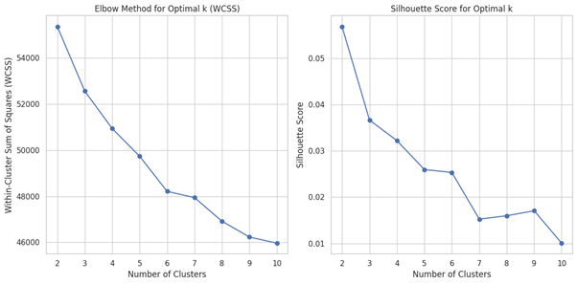
CLUSTERING APPROACHES- KPROTOTYPE
K-Prototypes Overview
Purpose: Handles mixed-type data by combining:
Euclidean distance for numerical variables.
Hamming distance for categorical variables (counts differing attributes).
Methodology
Preprocessing:
Identified categorical columns (12 to 138) and converted them to a categorical data type.
Initialization: Used the 'Cao' method to initialize clusters.
Clustering Process: Algorithm minimizes the total cost (Euclidean + Hamming distances) across clusters.
Cluster Exploration: Tested values of k from 2 to 10.
Notes:
K-Prototypes is designed for mixed-type data, utilizing Euclidean distance for numerical variables and Hamming distance for categorical variables. The algorithm minimizes the total cost by combining both .distances, and we explored values of k from 2 to 10 for optimal clustering.

Slide 25
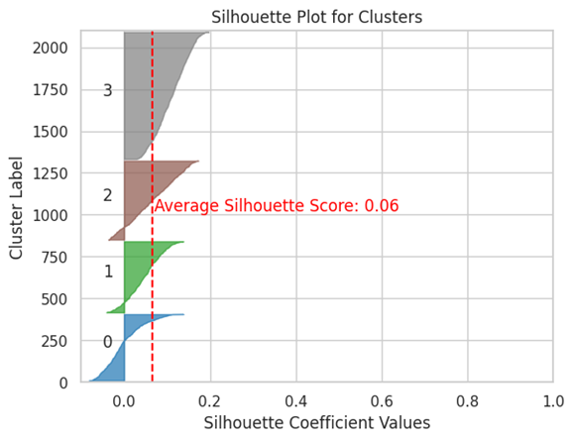
CLUSTERING APPROACHES- KPROTOTYPE
Evaluation Metrics
Within-Cluster Sum of Squares (WCSS):
Used WCSS to plot an elbow curve for determining the optimal number of clusters.
Silhouette Score:
Measured cluster cohesion and separation (ranges -1 to +1).
Average silhouette score: 0.06 (indicating poor separation).
Results
Optimal Clustering:
Elbow curve and silhouette scores suggested 4 clusters.
Low silhouette score implies poor cluster separation, indicating observations do not form distinct groups.
Notes:
We employed Within-Cluster Sum of Squares (WCSS) to create an elbow curve for determining the optimal number of clusters. The Silhouette Score, measured cluster separation, with an average score of 0.06 indicating poor separation.Therefore optimal number of clusters is 4, but the low silhouette score implies that the observations do not form distinct groups.

Slide 26
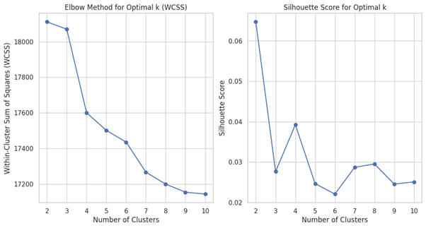
CLUSTERING APPROACHES- KMEDEODS
K-Medoids Overview
Purpose: Similar to K-Means but more resilient to outliers by using representative points (medoids) rather than centroids.
Distance Metric: Uses a generalized dissimilarity measure for both numerical and categorical data, without explicitly differentiating between Euclidean and Hamming distances.
Methodology
Preprocessing:
Converted categorical variables (columns 12-138) to the category data type.
Initialization: Set initial medoids using 'random' method.
Clustering Process: Minimized total dissimilarities between points and their closest medoids, iterating to select the most representative point for each cluster.
Cluster Exploration: Examined k values from 2 to 10 to identify optimal cluster segmentation.
Notes:
K-Medoids is similar to K-Means but is more resilient to outliers, using representative points (medoids) instead of centroids. It employs a generalized dissimilarity measure for both numerical and categorical data without distinguishing between distance types. minimized total dissimilarities between points and their closest medoids, exploring k values from 2 to 10 for optimal clustering.

Slide 27
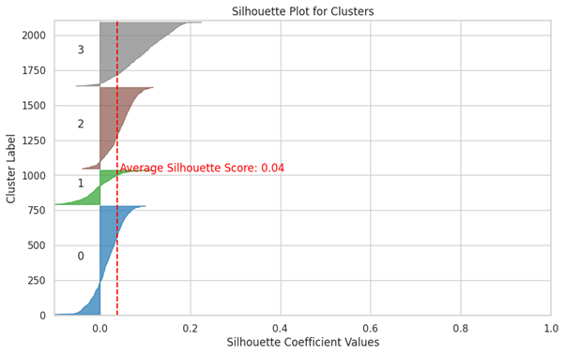
CLUSTERING APPROACHES- Kmedeods
Evaluation Metrics
Within-Cluster Sum of Squares (WCSS):
Calculated WCSS for each cluster count and plotted an elbow curve to help identify the optimal number of clusters.
Silhouette Score:
Evaluated cluster quality, with scores closer to 1 indicating clear separation.
Results
Optimal Clustering:
Elbow curve and silhouette score suggested 4 clusters.
Silhouette Score: Close to 0, indicating poor separation; points across different clusters were nearly as close to each other as to points within their clusters.
Notes:
The Silhouette Score, close to 0, indicated poor separation, with points in different clusters being nearly as close as those within the same cluster. Both metrics suggested 4 clusters, but the low silhouette score reflects a lack of distinct separation.

Slide 28
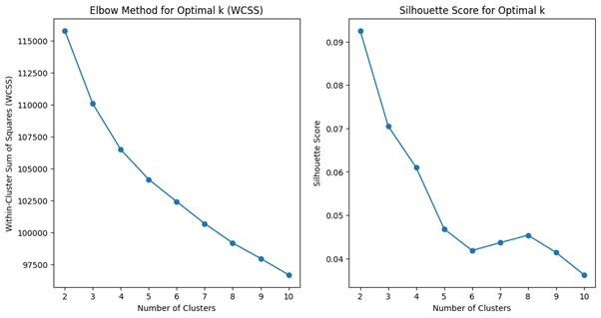
CLUSTERING APPROACHES- KMEANS
KMeans Overview
Purpose: Adapted KMeans to handle mixed-type data by incorporating a custom distance function.
Distance Calculation:
Euclidean distance for numerical variables.
Hamming distance for categorical variables.
Methodology
Preprocessing:
Converted categorical columns (12-138) to category types to facilitate the custom distance calculations.
Custom Distance Function:
Calculated Euclidean distance for numerical variables.
Used Hamming distance for categorical variables, counting attribute differences.
Combined both distances to compute the final distance between data points.
Hyperparameter Tuning:
Tested k values from 2 to 10, applying the custom distance function in KMeans for each value.
Notes:
We adapted K-Means to handle mixed-type data by implementing a custom distance function that incorporates both Euclidean distance for numerical variables and Hamming distance for categorical variables. Categorical columnswere converted to category types to facilitate these calculations. We tested k values from 2 to 10, applying the custom distance function in K-Means for each value to determine optimal clustering.

Slide 29
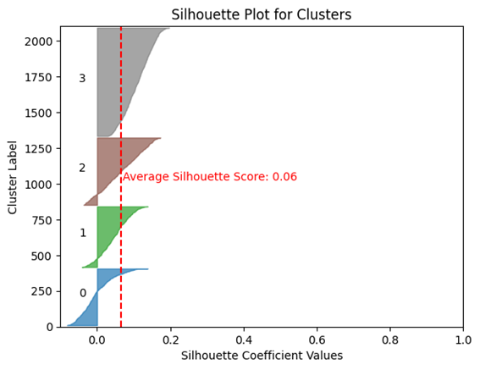
CLUSTERING APPROACHES- KMEANS
Evaluation Metrics
Within-Cluster Sum of Squares (WCSS):
Calculated WCSS across clusters, visualized using an elbow curve.
Silhouette Score:
Focused on the numerical data component for silhouette score reliability.
Results
Optimal Clustering:
Elbow curve and silhouette score suggested 4 clusters.
Silhouette Score: Remained low, indicating weak clustering structure with minimal natural separations.
Notes:
Both Within-Cluster Sum of Squares and The Silhouette Score metrics suggested 4 clusters, but the low silhouette score reflects a weak clustering structure with minimal natural separations.

Slide 30

ADVANCED ANALYSIS
The data set was split into training (80% of original data) and test (20%) tests in the pre-processing stage and a few select models were fitted on the training data and tested on the test data.
Notes:
The data set was split into training (80% of original data) and test (20%) tests in the pre-processing stage and a few select models were fitted on the training data and tested on the test data.

Slide 31


ADVANCED
ANALYSIS
Models were trained
Training Set
(80% of the Data)
Data Set
Test Set
(20% of the Data)
Models were evaluated
Notes:
And this is the outline.

Slide 32

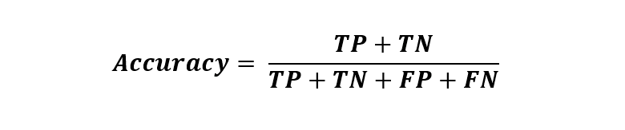

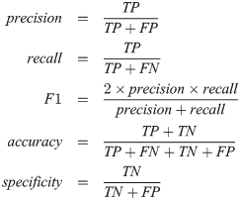
EVALUATION METRICS
Accuracy:
Overall correctness by comparing correctly predicted instances to total instances.
Offers a general performance view but may not account for class imbalance.
Precision:
Proportion of true positives among predicted positives.
Vital when the cost of false positives is high, ensuring predicted high-quality life instances are accurate.
Recall (Sensitivity):
Measures true positives relative to actual positives.
Key for identifying all relevant instances, crucial when capturing
all true positives is essential.
F1 Score:
Harmonic mean of Precision
and Recall, balancing both aspects.
Useful in class-imbalanced data
to evaluate nuanced performance.
Notes:
We have used 4 different evaluation metrics to evaluate the model performance such as Accuracy Precision Recall and F1 score

Slide 33
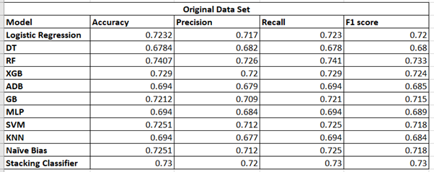

Considering the ORIGINAL DATA set
without applying hyper-parameter Tuning
The Gradient boosting model emerged as the top performer with evaluation metrics, accuracy: 74.07%, precision: 72.6%, F1-score: 74.1% and recall 73.3%.
Notes:
Initially, we fitted 10 different classification models on the original dataset without hyperparameter tuning. Among these, the Gradient Boosting Method outperformed the others.

Slide 34

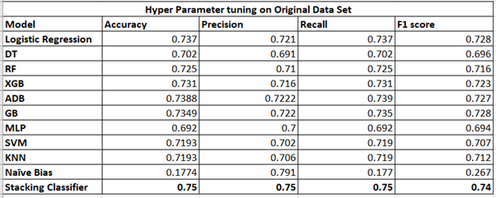
Considering the ORIGINAL DATA set
after applying hyper-parameter Tuning
The Stacking Classifier model emerged as the top performer with evaluation metrics, accuracy: 75%, precision: 75%, F1-score: 75% and recall: 74%.
Notes:
Next, we applied hyperparameter tuning to the same 10 models on the original dataset. This time, the Stacking Classifier model emerged as the best performer.

Slide 35


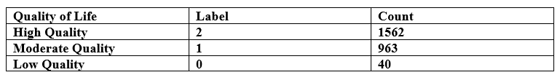
CLASS IMBALANCE OF RESPONSE
We observed a substantial class imbalance within our dataset for Quality of Life categories This distribution reflects an imbalance, with a significant underrepresentation of the low-quality category.
We have applied
SMOTE
Upsampling
Notes:
During the EDA phase, we noticed an imbalance in our response variable. This imbalance could lead to a strong tendency to classify new observations as high quality. To address this, we applied 2 different techniques: SMOTE, and upsampling,

Slide 36
Without Hyper-Parameter Tuning
With Hyper-Parameter Tuning
Original
With Hyper-Parameter Tuning
MODEL
FITTING
SMOTE
Without Hyper-Parameter Tuning
UPSAMPLING
Without Hyper-Parameter Tuning
With Hyper-Parameter Tuning
Notes:
In summary, we fitted the same 11 different classification models with and without hyperparameter tuning on the original dataset, as well as on datasets that were SMOTEd, upsampled,

Slide 37
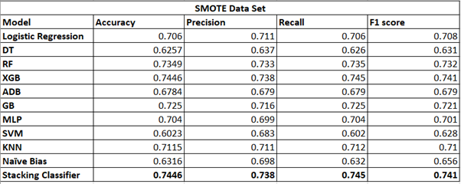
Considering the SMOTE DATA set
without applying hyper-parameter Tuning
The Stacking Classifier model emerged as the top performer with evaluation metrics, accuracy: 74.46%, precision: 73.8%, F1-score: 74.5% and recall: 74.1%.
Notes:
When using the SMOTE dataset without hyperparameter tuning, The Stacking ClassifieR showed better performance

Slide 38
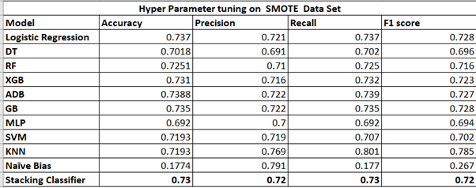
Considering the SMOTE DATA set
after applying hyper-parameter Tuning
Ada boosting and Stacking model performance well under smote data set with hyper parameter tuning.
Notes:
With hyperparameter tuning on the SMOTE dataset, Ada boosting and Stacking model performed well though it still underperformed compared to the model fitted on the original dataset

Slide 39
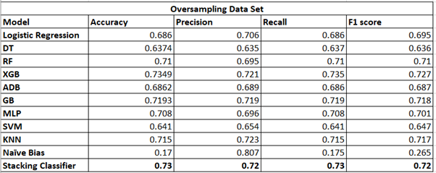
Considering the Upsampled DATA set
without applying hyper-parameter Tuning
The Stacking Classifier model emerged as the top performer with evaluation metrics, accuracy: 73%, precision: 72%, F1-score: 72% and recall: 73%.
Notes:
When using the uPSAMPLED dataset without hyperparameter tuning, The Stacking ClassifieR showed better performance

Slide 40
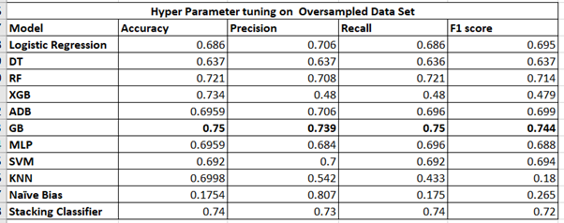
Considering the up-sampled DATA set
after applying hyper-parameter Tuning
Gradient Boost method emerged as the best model among the models with 75% accuracy.73.9% precision and 75% recall and 74.44% f1- score.
Notes:
When using the UPSAMPLED dataset AFTER hyperparameter tuning, Gradient Boost showed better performance

Slide 41

Best Model
The model with best evaluation metrics was considered as our best model.
The Stacking Classifier model fitted on original data without hyperparameter tuning has emerged as the top performer with evaluation metrics, accuracy: 75%, precision: 75%, F1-score: 75% and recall: 74%. which is the highest overall.
Notes:
by comparing all the models fitted we have selected
The Stacking Classifier model fitted on original data without hyperparameter tuning has emerged as the top performer

Slide 42

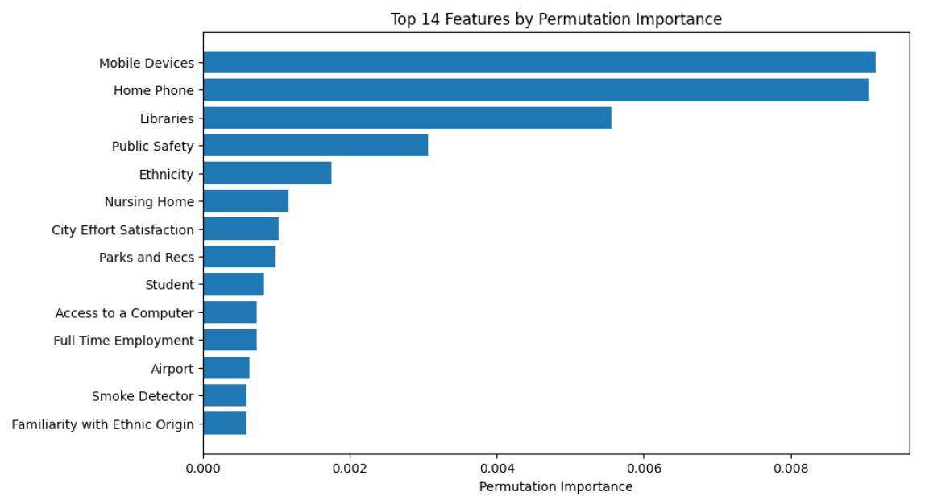
Feature Importance
We define the best model as the one with the highest Accuracy, F1 Score, and Recall. Initially using 146 features, we selected the top 14 to 25 most important ones to improve performance and simplify the model. The performance metrics were as follows:
Using 146 features: Accuracy = 0.75, F1 Score = 0.75, Recall = 0.74
Using 14 features: Accuracy = 0.73, F1 Score = 0.71, Recall = 0.73
Despite a slight decrease in performance with 14 features, we opted for this model due to its lower complexity and enhanced interpretability. The final model includes 14 key variables from a stacked ensemble fitted on the original dataset.
Notes:
we selected the top
14 to 25 most important ones to improve performance and simplify the model. The performance metrics were as follows
Despite
a slight decrease in performance with 14 features, we opted for this model due to its lower complexity and enhanced interpretability.
The final model includes 14 key variables from a stacked ensemble fitted on the original dataset.

Slide 43

DATA PRODUCT
Notes:
Let's dive deeper into our data product!

Slide 44



Developed Using
-Front End - React
-BackEnd - Python

Slide 45

CONCLUSIONS
Health status, civic engagement, financial staibility significnalty affects Quality of Life.
SMOTE and oversampling improved the model
Stacking classifier gives the highest accuracy
Data set is limited to Austin, Texas so hard to generalize
Smaller sample size for low Quality of Life category
Notes:
As a conclusion;
Quality of Life is significantly influenced by health status, civic engagement, and financial stability. Model performance improved with SMOTE and oversampling, with the stacking classifier achieving the highest accuracy. However, the dataset's limitation to Austin, Texas, and the small sample size for low Quality of Life make generalization challenging.

Slide 46


THANK YOU
Group Members
s15352 - Tharuka Fonseka
s15365 - Thusali Kodikara
s15680 - Hiruni Kudagama
s15771 - Kavishka Palihena

